Slide 1

Applied Machine Learning
1st semester Course project
MS (computational science and engineering)

Slide 2
Outline for Presentation
Team Formulation and work distribution
Selection of Project & Problem Formulation
Data set from Kaggle
Pre-processing on data set
Features Engineering
data clearing
Exploratory Data Analysis
Features Selection
Machine Learning model(s) development
Performance Evaluation
Deploy the Machine learning model on unseen data
Project video

Slide 3
Team Formulation
Work Distribution
task | Team member task distribution
Selection of Project & Problem Formulation | Abaidullah, Sharaz, Tehreem
Data set from Kaggle | Abaidullah, Sharaz, Tehreem
Pre-processing Features Engineering data clearing Exploratory Data Analysis | Sharaz, Tehreem Sharaz, Abaidullah, Tehreem Abaidullah
Features Selection | Abaidullah, Sharaz
Machine Learning model(s) development | Sharaz
Testing on unseen data | Abaidullah, Sharaz
Project Video | Tehreem
Team member:
Abaidullah Ramay
Sharaz Javed
Tehreem Tauseef

Slide 4
Selection of Project & Problem Formulation

Slide 5

Selection of Project
Project title
Used Car price prediction by using regression model
SDG # 9
Industry, innovation and infrastructure

Slide 6
Problem Formulation
Owning a car is a necessity, as it plays a signiﬁcant role in human transportation for different purposes.
However, with the current economic challenges, buying new cars in Pakistan is expensive which can be a burden.
Customer are not in favor of buying new cars due to the high cost , and they prefer to buy used cars due to their quality and lower price
So, the car market has shifted toward more affordable used cars. Due to the increasing number of used cars being sold

Slide 7
Problem Formulation
A “xyz” local automobile company deal with new and used cars to enter the market
Which feature are significant in predicting the price of a car
How well those feature describe the price of a car
Based on various market surveys, the firm has gathered a large dataset of different types of used cars selling across the market form Data set from Kaggle

Slide 8
Problem Formulation
ﬁnd empirical solutions by implementing a variety of machine learning techniques and big data tools on the prices of used cars.
Thus, we develop a regression model that can estimate used car prices based on various features
Problem statement
Development a predictors which predict the price of a used car based upon necessary feature

Slide 9
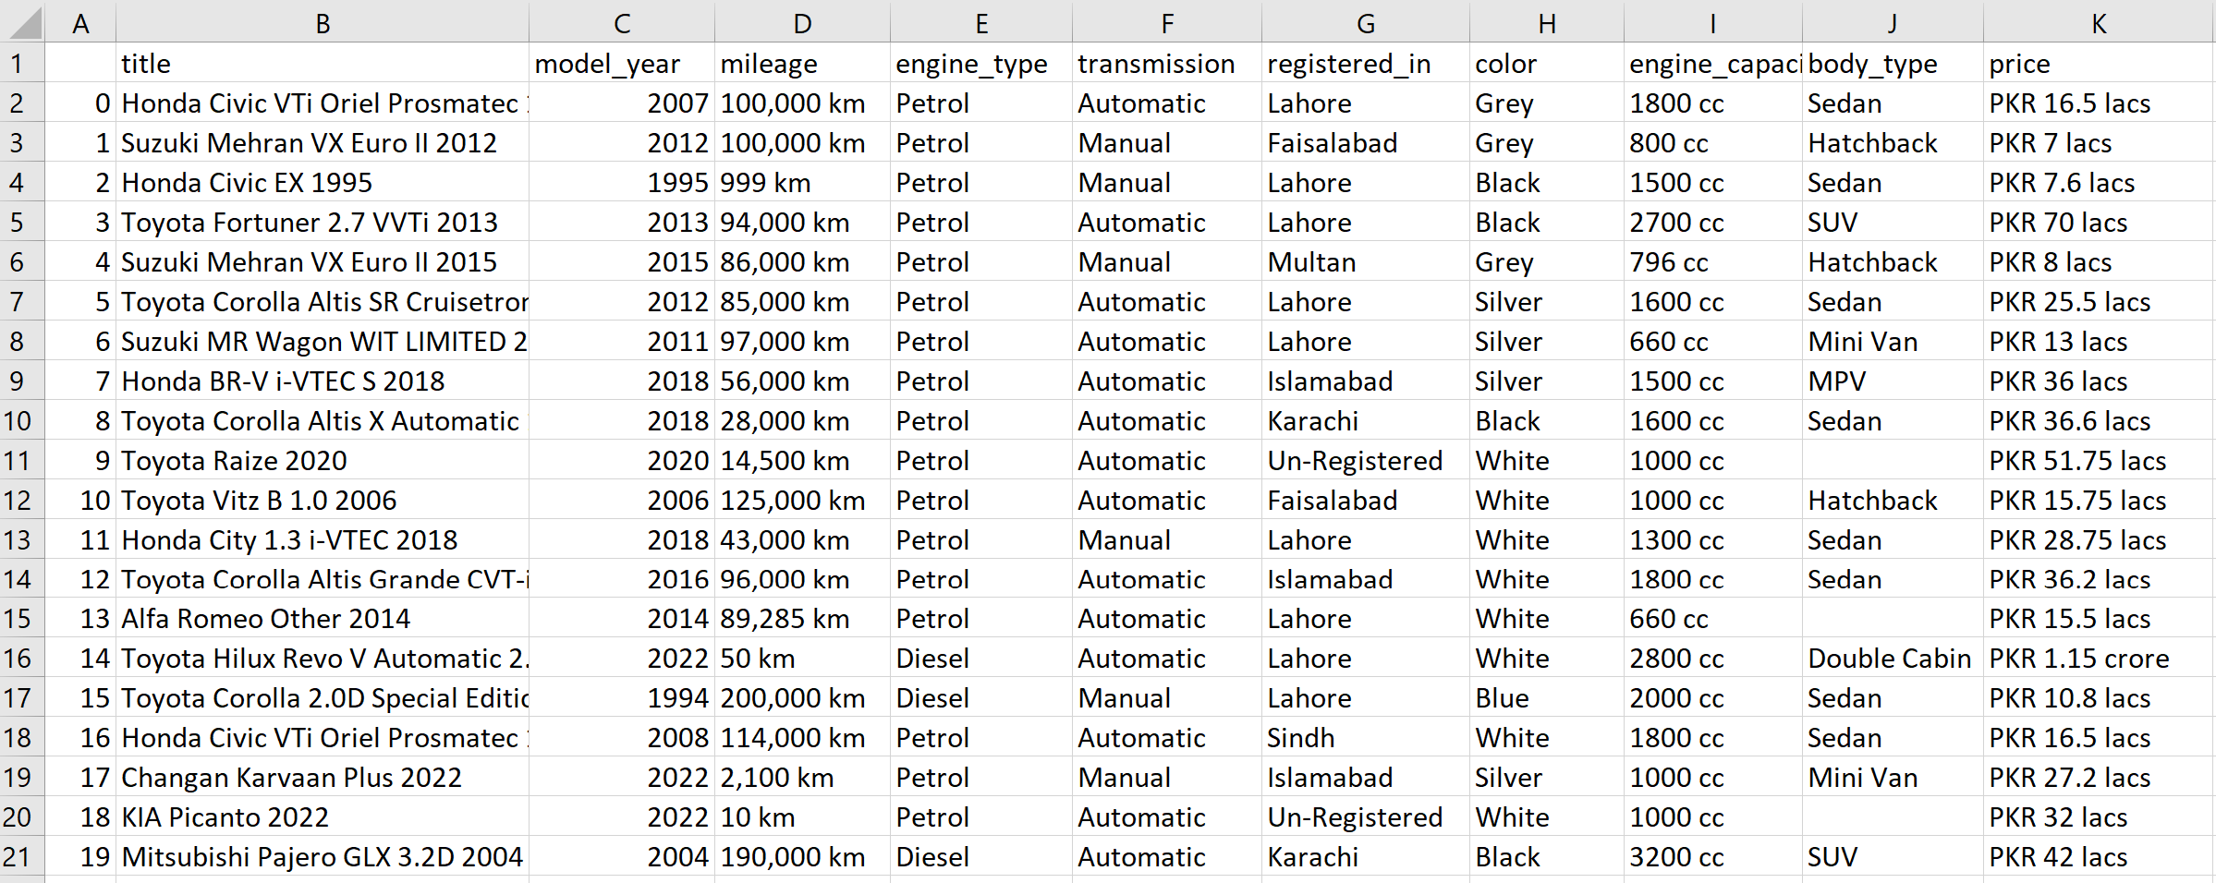
Data set from Kaggle
89955 entity
11 column

Slide 10
Pre-processing the data set

Slide 11
Pre-processing the data set
Step for data pre-processing steps:
Feature Engineering: Deriving new variables from available data.
Data Cleaning: Identifying and correcting mistakes or errors in the data.
Exploratory Data Analysis (EDA): understand data variables.

Slide 12
Features Engineering
“title” feature change into “carTitle”
Deriving “carcompany” (or carband) form “carTitle” feature variable
“model_year ” feature change into “ModelYear”
“Mileage” feature change into “Mileage(km)” - We need to remove “km” units.
“registered_in” feature change into “RegisteredCity”
carTitle | carCompany
Daihatsu Charade CS 1984 | Daihatsu
Toyota Corolla 1994 | Toyota
Suzuki Mehran VX 1990 | Suzuki

Slide 13
Features Engineering
“Color ” feature change into “CarColor”
“engine_capacity” feature change into “EngineCapacity(cc)” and remove “cc” units.
“body_type” feature change into “BodyType”
“Price ” feature change into “Price(PKR_lacs)” and remove PKR units “crore to lacs price”

Slide 14
Data Cleaning
Step for the data cleaning:
Remove the Missing value “null” or “NaN”
Identify and delete Rows that Contain Duplicate Data
Detect and Remove the outlier by boxplot by Setting the upper and lower limit on feature value

Slide 15
Setting the limit on feature value to remove outlier
Setting the upper and lower limit on the feature value:
“Modelyear” feature limit “1985-2022”
“Mileage(km)” feature limit “300 km - 60000 km” and remove “12345” and “zero” value
“EngineCapacity(cc)” feature limit “600cc -6200cc” value
“Price(PKR_lacs)” feature range “6.45 lacs – 150 lacs”

Slide 16
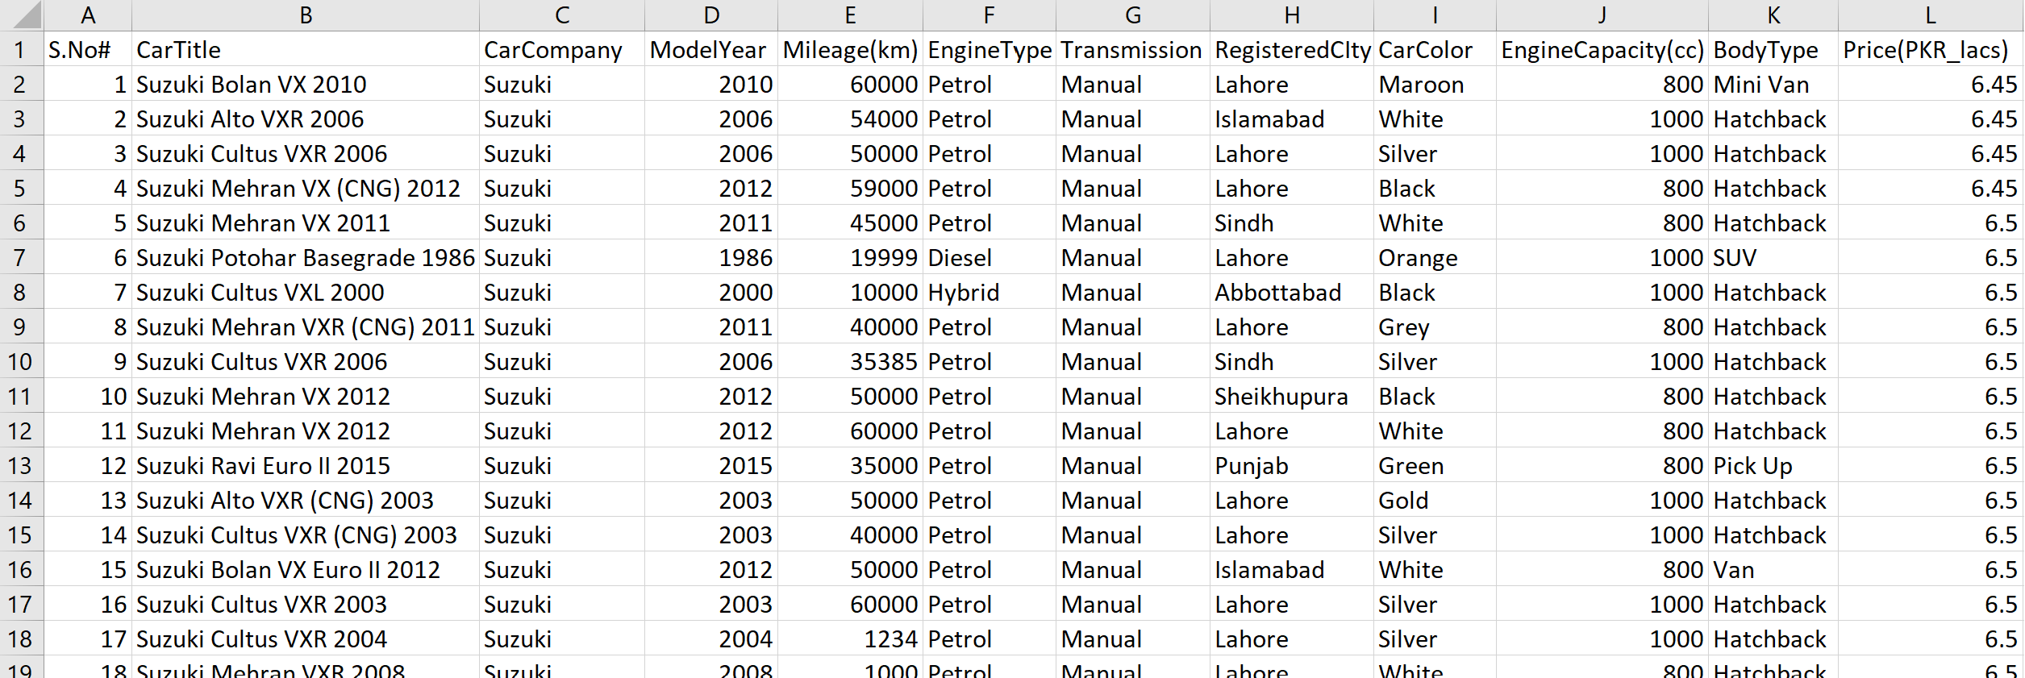
After Features Engineering and data Cleaning
89955 entity
11 column
11713 entity
12 column
Data set from Kaggle
Pre processing data set

Slide 17
Exploratory Data Analysis
Step for Exploratory Data Analysis:
Feature variable classification for data set
into Continuous and Categorical feature
Into input and target features variable
Visualization and Understanding Continuous feature variable
Histogram and boxplot Continuous variable
Skewness & Kurtosis of Continuous variable
Visualization and Understanding categorical feature variable
Histogram of categorical variable
Relation between target and categorical variable

Slide 18
Feature variable classification for data
S.no | Feature variable | Data type
1 | S.No. | Int64
2 | carTitle | object “string”
3 | carCompany | object “string and categorical”
4 | ModelYear | Int64
5 | Mileage(km) | Int64
6 | EngineType | object “string and categorical”
7 | Transmission: | object “string and categorical”
8 | RegisteredCIty | object “string and categorical”
9 | CarColor | object “string and categorical”
10 | EngineCapacity(cc) | Int64
11 | BodyType: | object “string and categorical”
12 | Price(PKR_lacs) | float64
Feature variable classification into
Continuous feature
Categorical feature
S.no | Categorical feature
3 | carcompany
6 | EngineType
7 | Transmission
8 | RegisteredCIty
9 | CarColor:
11 | BodyType:
S.no | Continuous feature
4 | ModelYear
5 | Mileage(km)
10 | EngineCapacity(cc)
12 | Price(PKR_lacs)

Slide 19
Separating input and target features variable
S.no | Feature variable
1 | S.No.
2 | carTitle
3 | carcompany
4 | ModelYear
5 | Mileage(km)
6 | EngineType
7 | Transmission
8 | RegisteredCIty
9 | CarColor:
10 | EngineCapacity(cc)
11 | BodyType
12 | Price(PKR_lacs)
S.no | Input Continuous feature
4 | ModelYear
5 | Mileage(km)
10 | EngineCapacity(cc)
S.no | Input Feature variable
3 | carcompany
4 | ModelYear
5 | Mileage(km)
6 | EngineType
7 | Transmission
8 | RegisteredCIty
9 | CarColor
10 | EngineCapacity(cc)
11 | BodyType
S.no | Input Categorical feature
3 | carcompany
6 | EngineType
7 | Transmission
8 | RegisteredCIty
9 | CarColor
11 | BodyType
S.no | Continuous target feature
12 | Price(PKR_lacs)

Slide 20
Features Selection

Slide 21
Features Selection
Step for Features selection:
Deleting the features which are logically useless.
Visual exploration and Statistical measurement of relationship between continuous features and target feature Price(PKR_lacs) ----- Scatter plot and Correlation Matrix

Slide 22
Features Selection
Deleting the features which are logically useless.
“S.no”
“carTitle” feature engineering “carcompany”
Visual exploration and Statistical measurement of relationship between continuous features and target feature Price(PKR_lacs)
Scatter plot between continuous feature(s) and continuous target feature
Correlation Matrix between continuous feature(s) and continuous target feature

Slide 23
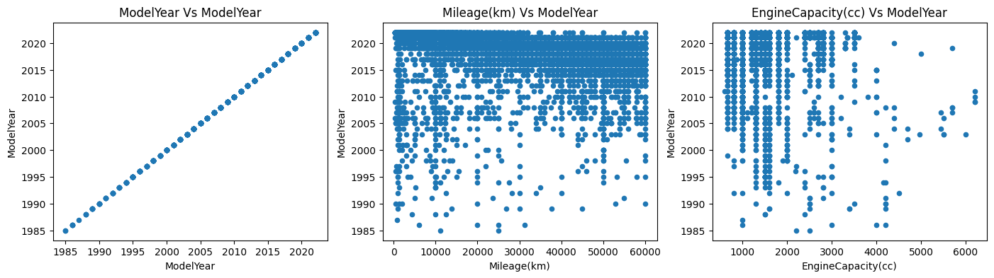
Scatter plot between continuous(s) feature
Decreasing Trend
Between modelyear and milage(km)
Increasing Trend(little)
Between modelyear and enginecapacity(cc)
Notes:
The scatter plots give an idea about how the two variables are correlated.
1. Increasing Trend: This means both variables are positively correlated. In other words, they are directly proportional to each other, an increase in one variable causes an increase in other variable. This is good for ML!
2. Decreasing Trend: This means both variables are negatively correlated. In other words, they are inversely proportional to each other, an increase in one variable causes a decrease in other variable. This is also good for ML!
3. No Trend: We cannot see any clear increasing or decreasing trend. This means there is no correlation between the variables. Hence the predictor cannot be used for ML.

Slide 24
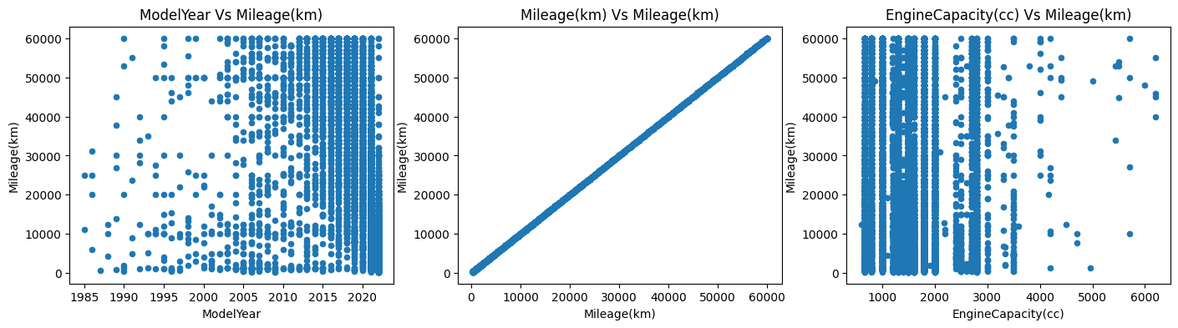
Scatter plot between continuous(s) feature
Decreasing Trend
Between modelyear and milage(km)
Increasing Trend
Between modelyear and enginecapacity(cc)
Notes:
The scatter plots give an idea about how the two variables are correlated.
1. Increasing Trend: This means both variables are positively correlated. In other words, they are directly proportional to each other, an increase in one variable causes an increase in other variable. This is good for ML!
2. Decreasing Trend: This means both variables are negatively correlated. In other words, they are inversely proportional to each other, an increase in one variable causes a decrease in other variable. This is also good for ML!
3. No Trend: We cannot see any clear increasing or decreasing trend. This means there is no correlation between the variables. Hence the predictor cannot be used for ML.

Slide 25
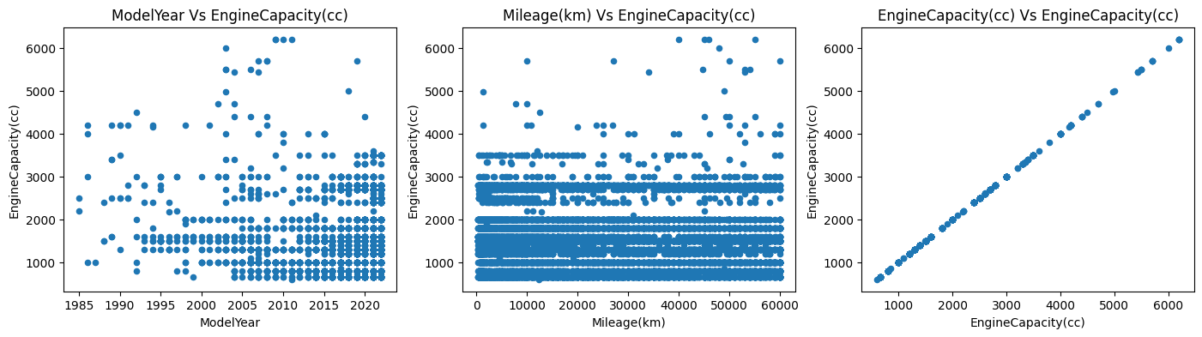
Scatter plot between continuous(s) feature
Increasing Trend
Between price and milage(km)
Increasing Trend
Between price and enginecapacity(cc)
Notes:
The scatter plots give an idea about how the two variables are correlated.
1. Increasing Trend: This means both variables are positively correlated. In other words, they are directly proportional to each other, an increase in one variable causes an increase in other variable. This is good for ML!
2. Decreasing Trend: This means both variables are negatively correlated. In other words, they are inversely proportional to each other, an increase in one variable causes a decrease in other variable. This is also good for ML!
3. No Trend: We cannot see any clear increasing or decreasing trend. This means there is no correlation between the variables. Hence the predictor cannot be used for ML.

Slide 26
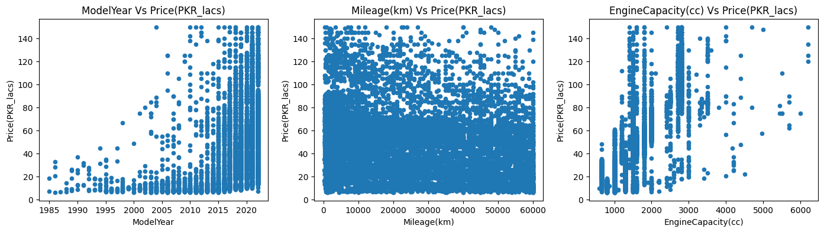
Scatter plot between continuous and target feature
Increasing Trend
Between price and model year
Decreasing Trend
Between price and milage(km)
Increasing Trend
Between price and enginecapacity(cc)
Notes:
The scatter plots give an idea about how the two variables are correlated.
1. Increasing Trend: This means both variables are positively correlated. In other words, they are directly proportional to each other, an increase in one variable causes an increase in other variable. This is good for ML!
2. Decreasing Trend: This means both variables are negatively correlated. In other words, they are inversely proportional to each other, an increase in one variable causes a decrease in other variable. This is also good for ML!
3. No Trend: We cannot see any clear increasing or decreasing trend. This means there is no correlation between the variables. Hence the predictor cannot be used for ML.

Slide 27
Correlation Matrix between continuous and target feature
We will confirm this with Pearson's Correlation Coefficient.
Continuous feature | ModelYear | Mileage(km) | EngineCapacity(cc) | Price(PKR_lacs)
ModelYear | 1.000000 | -0.328520 | 0.045987 | 0.346422
Mileage(km) | -0.328520 | 1.000000 | -0.090632 | -0.213559
EngineCapacity(cc) | 0.045987 | -0.090632 | 1.000000 | 0.793069
Price(PKR_lacs) | 0.346422 | -0.213559 | 0.793069 | 1.000000
> 0.3
Notes:
------ Pearson correlation coefficient Results ------
ModelYear
Pearsons correlation between Price(PKR_lacs) and ModelYear : 0.4232036556167016
Pearsons correlation absolute value between Price(PKR_lacs) and ModelYear : 0.4232036556167016
As correlation between Price(PKR_lacs) and ModelYear is greater than 0.3
ModelYear is correlated with Price(PKR_lacs) ----------------------------------------------------------------------- Mileage(km) Pearsons correlation between Price(PKR_lacs) and Mileage(km) : -0.2975524882920423 Pearsons correlation absolute value between Price(PKR_lacs) and Mileage(km) : 0.2975524882920423 As correlation between Price(PKR_lacs) and Mileage(km) is less than 0.3 Mileage(km) is NOT correlated with Price(PKR_lacs) ----------------------------------------------------------------------- EngineCapacity(cc) Pearsons correlation between Price(PKR_lacs) and EngineCapacity(cc) : 0.6626833229229925 Pearsons correlation absolute value between Price(PKR_lacs) and EngineCapacity(cc) : 0.6626833229229925 As correlation between Price(PKR_lacs) and EngineCapacity(cc) is greater than 0.3 EngineCapacity(cc) is correlated with Price(PKR_lacs) ----------------------------------------------------------------------- Price(PKR_lacs) Pearsons correlation between Price(PKR_lacs) and Price(PKR_lacs) : 1.0 Pearsons correlation absolute value between Price(PKR_lacs) and Price(PKR_lacs) : 1.0 As correlation between Price(PKR_lacs) and Price(PKR_lacs) is greater than 0.3 Price(PKR_lacs) is correlated with Price(PKR_lacs) ----------------------------------------------------------------------- Selected features are : ['ModelYear', 'EngineCapacity(cc)', 'Price(PKR_lacs)']

Slide 28
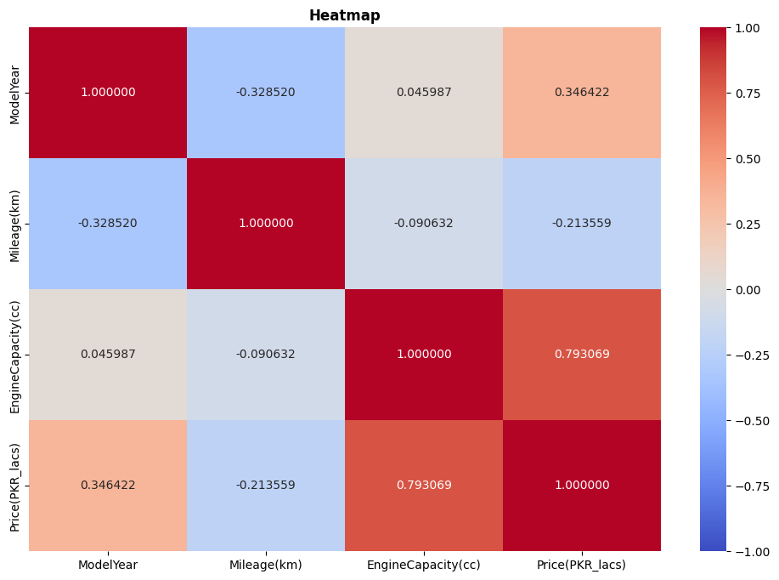
Heatmap between continuous and target feature
> 0.3

Slide 29
Features Selection
S.no | Input Continuous feature
4 | ModelYear
5 | Mileage(km)
10 | EngineCapacity(cc)
S.no | Input Continuous feature
4 | ModelYear
10 | EngineCapacity(cc)
S.no | Input selected Feature variable
3 | carcompany
4 | ModelYear
6 | EngineType
7 | Transmission:
8 | RegisteredCIty
9 | CarColor
10 | EngineCapacity(cc)
11 | BodyType
S.no | Input Categorical feature
3 | carcompany
4 | ModelYear
6 | EngineType
7 | Transmission
8 | RegisteredCIty
9 | CarColor
11 | BodyType

Slide 30
Machine Learning Model Development

Slide 31
Machine Learning Model Development
Step for building machine learning model
Separating data into input features variable and target features variable
Split the data in Train data and test data
Encoding and Scaling of train data
Model training and testing and Performance Evaluation
Model 1 -- Linear Regression
Model 2 -- Ridge Regression
Model 3 -- Support Vector Regression (SVR)
Supervised Machine Learning Regression Predictive Model

Slide 32
Separating input and target features variable
S.no | Feature variable
1 | S.No.
2 | carTitle
3 | carcompany
4 | ModelYear
5 | Mileage(km)
6 | EngineType
7 | Transmission:
8 | RegisteredCIty
9 | CarColor:
10 | EngineCapacity(cc)
11 | BodyType:
12 | Price(PKR_lacs)
S.no | Input Continuous feature
4 | ModelYear
10 | EngineCapacity(cc)
S.no | Input selected Feature variable
3 | carcompany
4 | ModelYear
6 | EngineType
7 | Transmission:
8 | RegisteredCIty
9 | CarColor
10 | EngineCapacity(cc)
11 | BodyType
S.no | Input Categorical feature
3 | carcompany
6 | EngineType
7 | Transmission
8 | RegisteredCIty
9 | CarColor
11 | BodyType
S.no | Continuous target feature
12 | Price(PKR_lacs)

Slide 33
Split the data in Train data and test data
Split data onto to part one in
training data 70%
testing data 30%

Slide 34
Encoding and Scaling of train data
Convert Categorical variable into dummy/indicator variables using “pandas.get_dummies”
Then Transform features by scaling each feature to a given range by using “sklearn.preprocessing.MinMaxScaler”

Slide 35
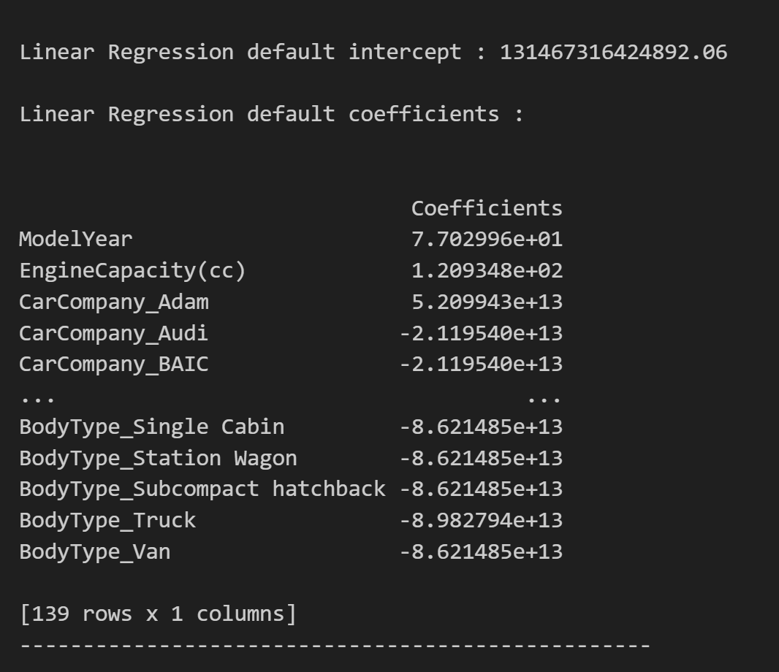
Learning Model training and testing
Model 1
Linear
Regression

Slide 36
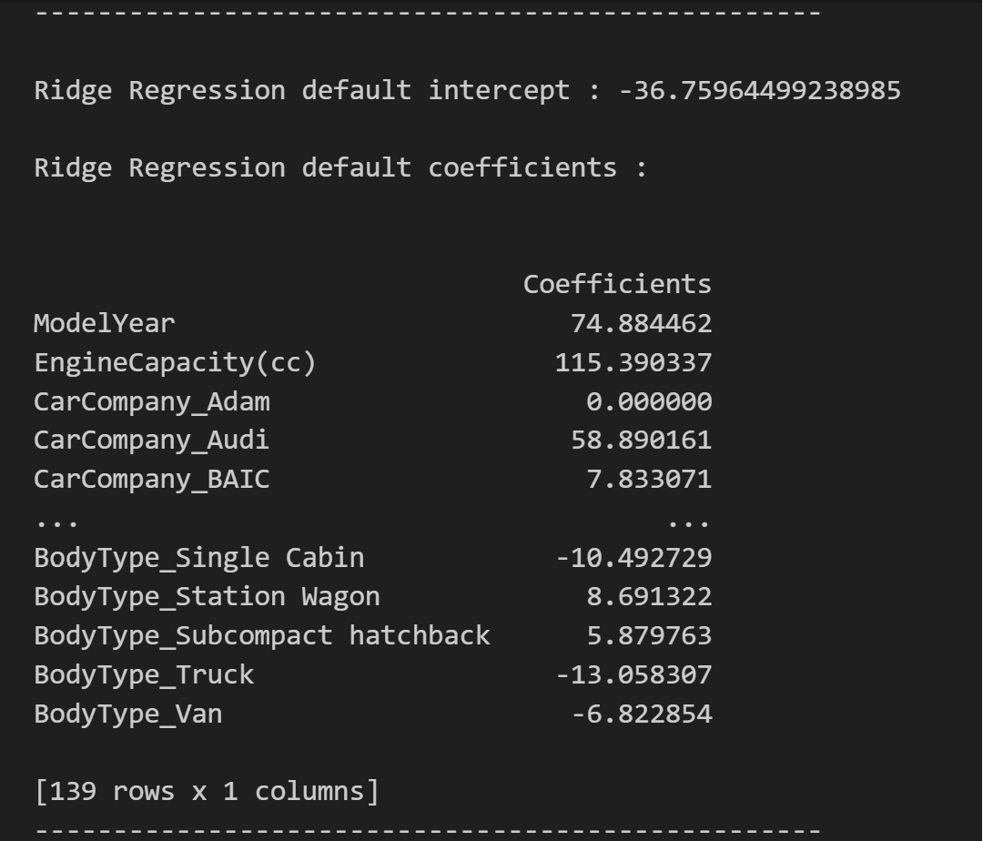
Learning Model training and testing
Model 2&3
Ridge
Regression

Slide 37
Learning Model training and testing
SVR default Model parameters:
{
'C': 1.0,
'cache_size': 200,
'coef0': 0.0,
'degree': 3,
'epsilon': 0.1,
'gamma': 'scale’,
'kernel': 'rbf’,
'max_iter': -1,
'shrinking': True,
'tol': 0.001,
'verbose': False
}
SVR default Model intercept :[43.21365514]
Model 3
Support Vector Regression (SVR)

Slide 38
Performance Evaluation
Model training
Model 1 -- Linear Regression
Model 2 -- Ridge Regression
Model 3 -- Support Vector Regression (SVR)
For the Performance evaluation of regression model are following
Mean absolute error (MAE)
Mean square error (MSE)
Root mean square error (RMSE)
R-squared error (R2)

Slide 39
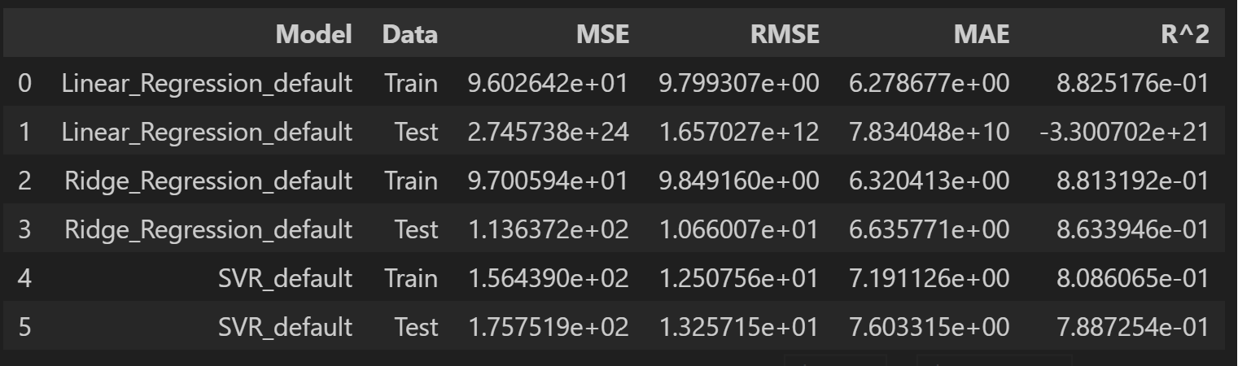
Performance Evaluation

Slide 40
Testing on unseen data

Slide 41
Testing on unseen data
Step to deploy Model on unseen data
Model training by 100% of given data and Performance Evaluation
Linear regression model
Ridge regression model
Support Vector Regression (SVR) model
Load ,encoding, scaling the unseen data
apply these “model” on the unseen data
Add “PredictedPrice” column in unseen data

Slide 42
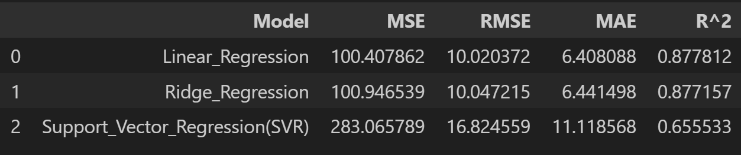
Model training by 100% of data and Performance Evaluation
model training these model by 100% of data
linear regression model
Ridge regression model
Support Vector Regression (SVR) model
Performance Evaluation on train 100% data

Slide 43
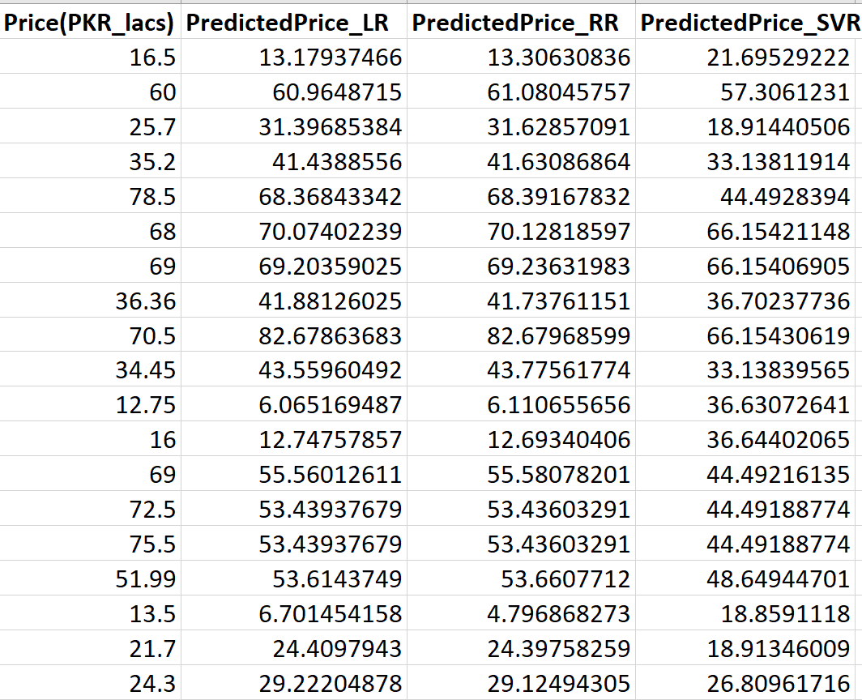
Testing on unseen data

Slide 44



Slide 45
Visualization and Understanding Continuous feature variable
Price(PKR_LACS)
ModelYear
Mileage(km)
EngineCapacity(cc)

Slide 46
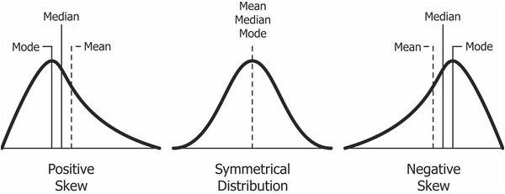
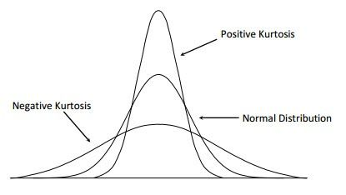
Skewness & Kurtosis
Skewness value | Type of skewness
lower than -1 | negative skewed
-1 to -0.5 | Slight negative skewed
-0.5 to 0.5 | nearly symmetrical skewness
0.5 to 1 | Slight positive skewed
greater than 1 | positive skewed
Kurtosis value | Type of Kurtosis
greater than +2, | too peaked
close to zero | normal distribution.
less than −2 | too flat
Notes:
Thumb rules for skewness
1. If the skewness is between -0.5 & 0.5, the data are nearly symmetrical.
2. If the skewness is between -1 & -0.5 (negative skewed) or between 0.5 & 1(positive skewed), the data are slightly skewed.
3. If the skewness is lower than -1 (negative skewed) or greater than 1 (positive skewed),
Thumb rules for kurtosis
1. if the kurtosis is greater than +2, the distribution is too peaked.
2. A kurtosis of less than −2 indicates a distribution that is too flat.
3. When the kurtosis is close to zero, the pattern of responses is considered a normal distribution.

Slide 47
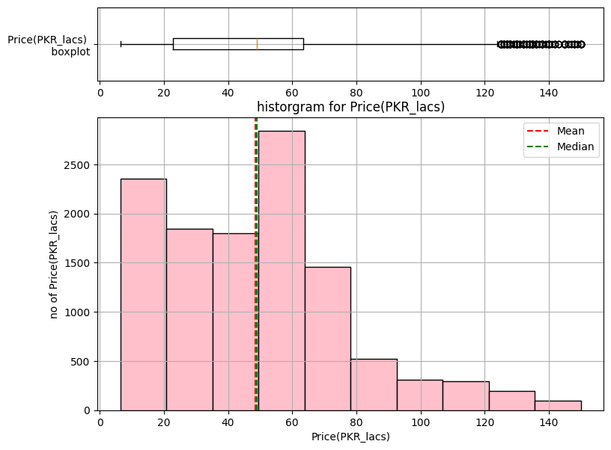
Visualization and Understanding target feature
Description statistic | Target value
mean | 48.596 lacs
standard deviation (std) | 28.667 lacs
Q1, lower quartile , 25% | 22.75 lacs
Q2, median , 50% | 49.00 lacs
Q3, upper quartile,75% | 63.50 lacs
Min | 6.450 lacs
max | 150.00 lacs
Skewness | 0.80655671
kurtosis | 0.65550744

Slide 48
Visualization and Understanding target feature
Price(PKR_lacs) columns is target continuous variable for our machine learning model
There are “1309” different Prices for which cars can be sold.
“179” is Highest number of cars range for 55.00 Lakhs to Rs.65.00 Lakhs
The lowest selling price is Rs. 6.45 Lakhs and highest selling price is Rs. 150 Lakhs.
The skewness of Price 0.80655671 which is between 0.5 and 1, hence the data series of Price is slightly positive skewed.
The kurtosis of Price is 0.65550744 which is very close to zero, hence the distribution is considered a normal distribution.

Slide 49
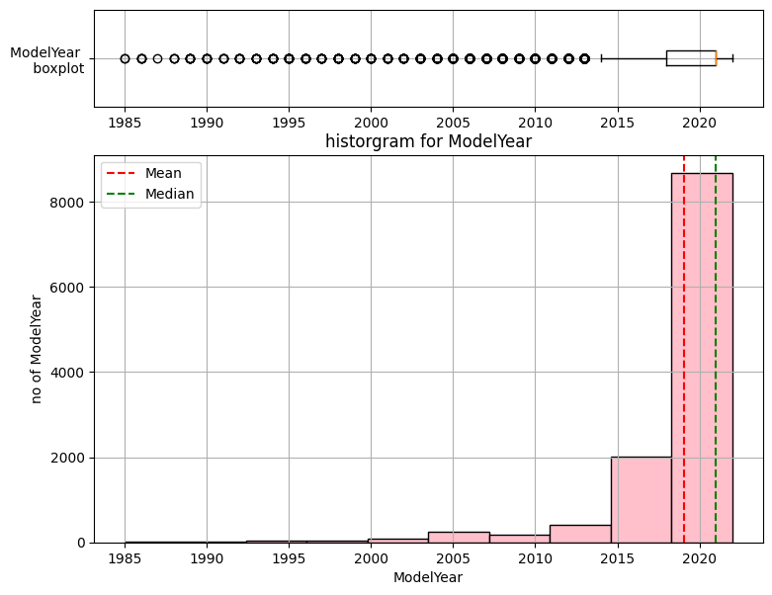
Visualization and Understanding ModelYear variable
Description statistic | Target value
mean | 2019.0653
standard deviation (std) | 4.318666
Q1, lower quartile , 25% | 2018.00
Q2, median , 50% | 2021.00
Q3, upper quartile,75% | 2021.00
Min | 1985.00
max | 2022.00
Skewness | -3.178150242
kurtosis | 13.019607099

Slide 50
Visualization and Understanding modelyear feature
“ModelYear” columns is input continuous variable for our machine learning model
There are “38” different modelyear for which cars can be sold.
Min year model is 1985 and latest model is 2022
“3565” Highest number of cars modelyear 2021
The skewness of Model year is -3.178150242 which is lower than -1 hence the data series of Model year is negative skewed
The kurtosis of model year is 13.019607099 which is greater than +2 hence the distribution is considered a too peaked distribution.

Slide 51
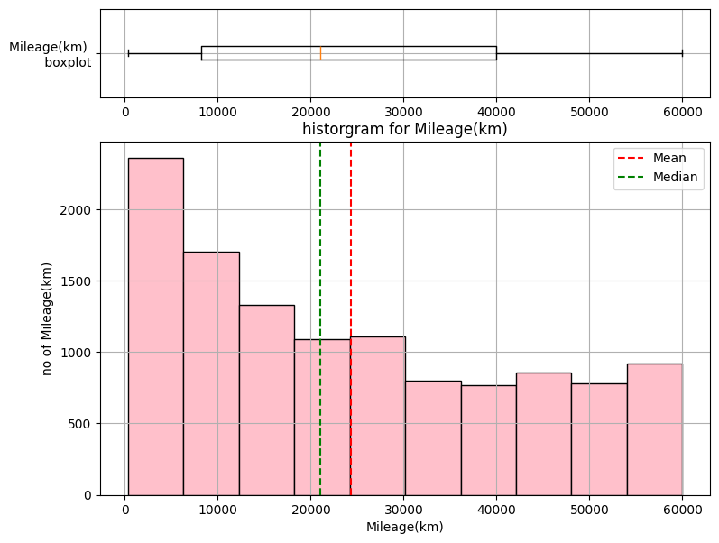
Visualization and Understanding Mileage(km) variable
Description statistic | Target value
mean | 24334.524033
standard deviation (std) | 18085.145781
Q1, lower quartile , 25% | 8200.00
Q2, median , 50% | 21000.00
Q3, upper quartile,75% | 40000.00
Min | 304.00
max | 60000.00
Skewness | 0.430406631
kurtosis | -1.08428494

Slide 52
Visualization and Understanding Mileage(km) variable
“Mileage(km)” columns is input continuous variable for our machine learning model
there are “1639” different milage driven for which cars can be sold
Min “304 km” to max “60000 km”
“261” max number of Mileage in “60000 km”
The skewness of Mileage is 0.430406631 which is between -0.5 & 0.5, hence of Mileage is nearly symmetrical.
The kurtosis of Mileage of car -1.08428494 which is near zero hence the distributions is normal

Slide 53
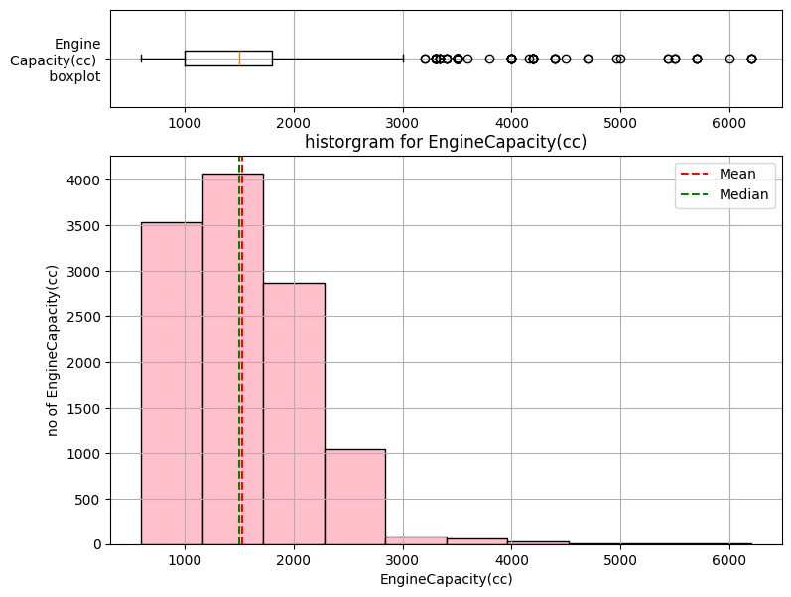
Visualization and Understanding EngineCapacity(cc) variable
Description statistic | Target value
mean | 1525.587 cc
standard deviation (std) | 634.555 cc
Q1, lower quartile , 25% | 1000.00 cc
Q2, median , 50% | 1500.00 cc
Q3, upper quartile,75% | 1800.00 cc
Min | 600.00 cc
max | 6200.00 cc
Skewness | 1.075981781
kurtosis | 3.021270291

Slide 54
Visualization and Understanding EngineCapacity(cc) variable
“EngineCapacity(cc)” columns is input continuous variable for our machine learning model
there “48” different EngineCapacity(cc) for which cars can be sold
“2351” is the highest number of “1500 cc” car
Min car “600 cc” and max car Engine capacity is of “6208 cc”
3. The skewness of EngineCapacity(CC) is 1.075981781 hence the EngineCapacity(cc) is slightly positive skewed.
3. The kurtosis of EngineCapacity is 3.021270291 which is greater than +2, hence the distributions is too peaked.

Slide 55
Visualization and Understanding categorical feature variable
CarCompany
EngineType
Transmission
RegisteredCity
CarColor
BodyType

Slide 56
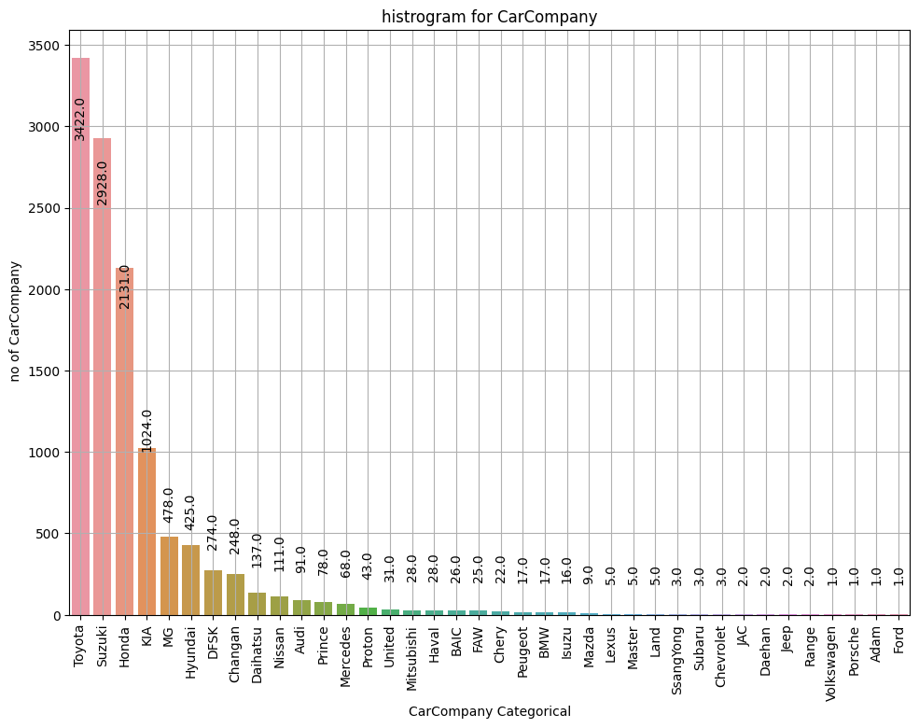
Visualization and Understanding carCompany variable
Most carCompany
Toyota
Suzuki
Honda
Least carcompany
Porsche
Adam
Ford

Slide 57
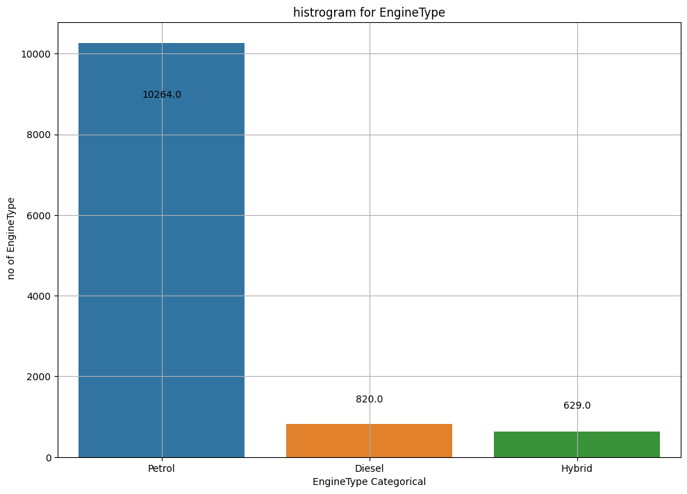
Visualization and Understanding EngineType variable
Most EngineType
Petrol
Least EngineType
Hybrid

Slide 58
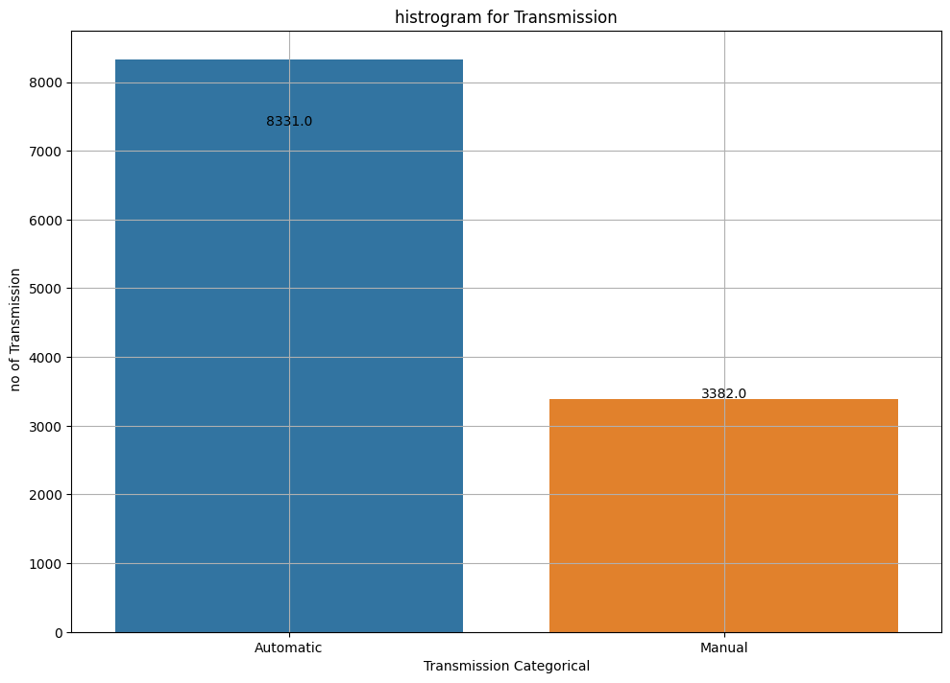
Visualization and Understanding Tranmission variable
Most transmission
automatic
Least transmission
manual

Slide 59
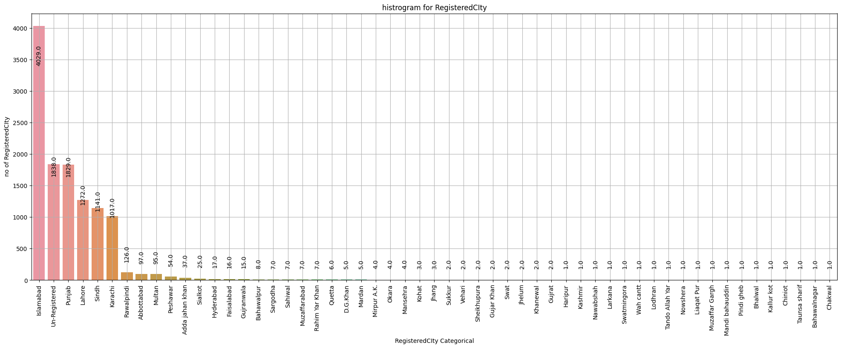
Visualization and Understanding RegisteredCity variable
Most Registered City
Islamabad
Lahore
karachi
Unregistered

Slide 60
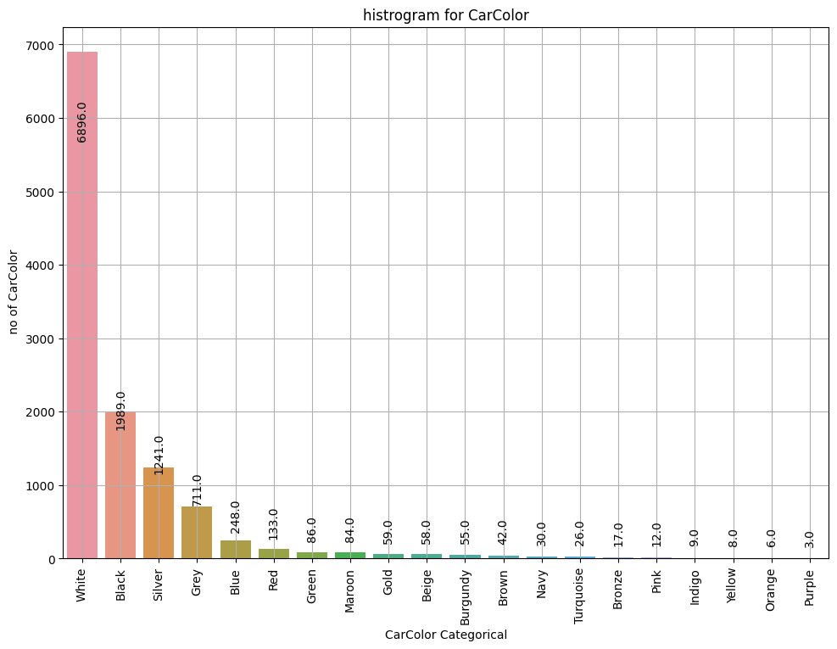
Visualization and Understanding CarColor variable
Most car colour
White
Black
silver
grey

Slide 61
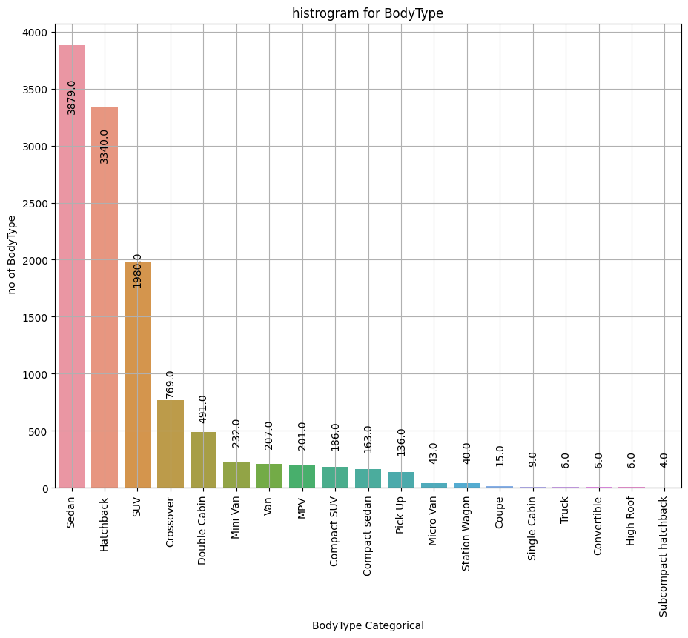
Visualization and Understanding BodyType variable
Most bodytype
Sedan
Hatchback
SUV

Slide 62
Visualization and Understanding Relation between categorical and Continuous target feature
CarCompany V.S. price (PKR_Lacs)
EngineType V.S. price (PKR_Lacs)
Transmission V.S. price (PKR_Lacs)
RegisteredCity V.S. price (PKR_Lacs)
CarColor V.S. price (PKR_Lacs)
BodyType V.S. price (PKR_Lacs)

Slide 63
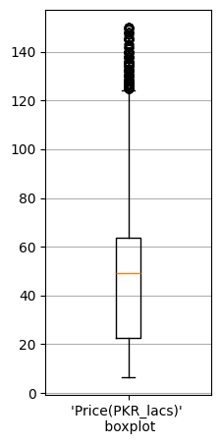
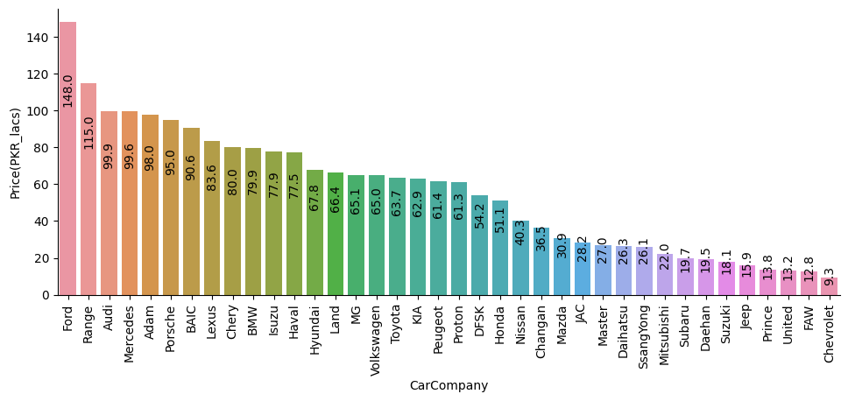
Visualization and Understanding Relation between carcompany and Continuous target
Least no of carcompany are Most expensive carCompany
Ford
Range
Audi
Most No. of carcompany are Economy class carCompany
Toyota – 63.7 lacs
Honda -- 51.1 lacs
Suzuki – 18.1 lacs
(mean price)
63.5 lacs
49.00 lacs
22.75 lacs

Slide 64
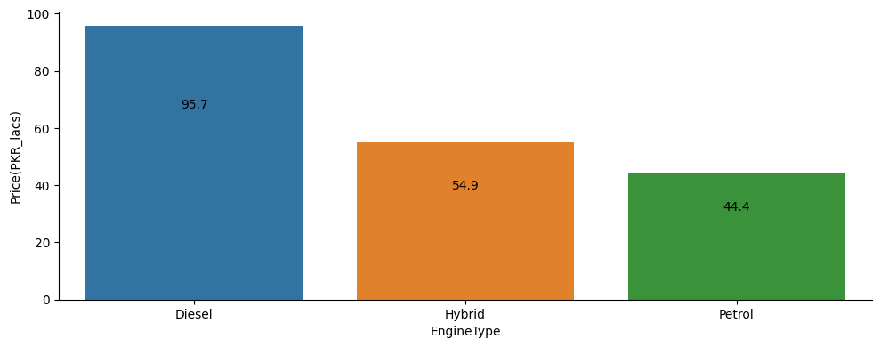
Visualization and Understanding Relation between EngineType and Continuous target
Diesel enginetype car are expensive
Petrol and hybrid enginetype are the Economy
63.5 lacs
49.00 lacs
22.75 lacs

Slide 65
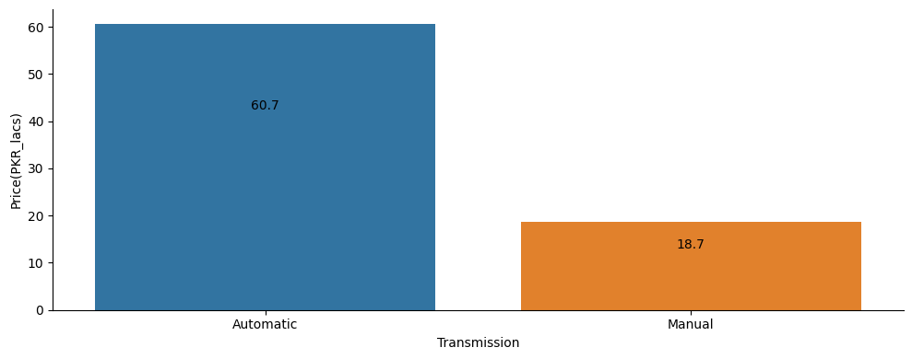
Visualization and Understanding Relation between Transmission and Continuous target
Automatic and manual transmission are the Economy class
63.5 lacs
49.00 lacs
22.75 lacs

Slide 66
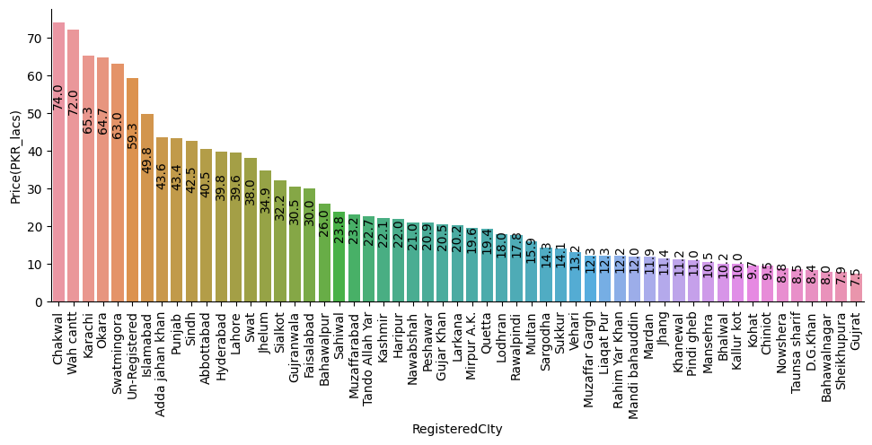
Visualization and Understanding Relation between Registeredcity and Continuous target
Chakwal, Wah Cantt and Karachi registered city car are expensive
Islamabad and unregistered car are economy class
63.5 lacs
49.00 lacs
22.75 lacs

Slide 67
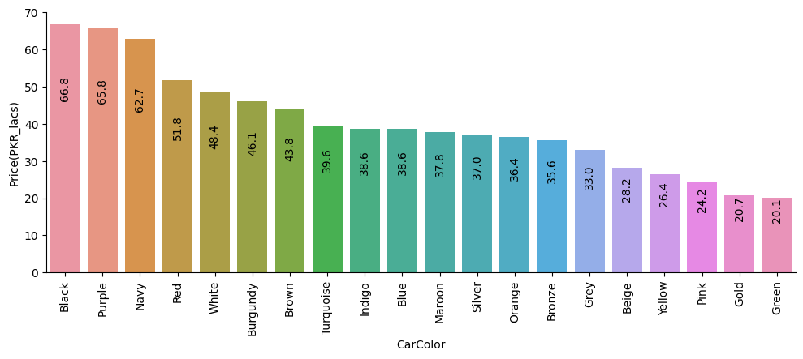
Visualization and Understanding Relation between CarColor and Continuous target
Black and purple color car are expensive
White , Silver, grey color car are economy class
63.5 lacs
49.00 lacs
22.75 lacs

Slide 68
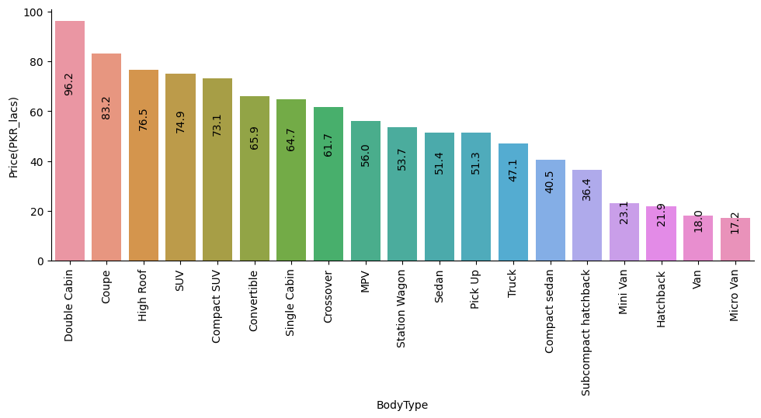
Visualization and Understanding Relation between bodytype and Continuous target
Double cabin, Couple, SUV body type car are expensive
Sedan and hatchback body type car are economy class
63.5 lacs
49.00 lacs
22.75 lacs

